Slide 1
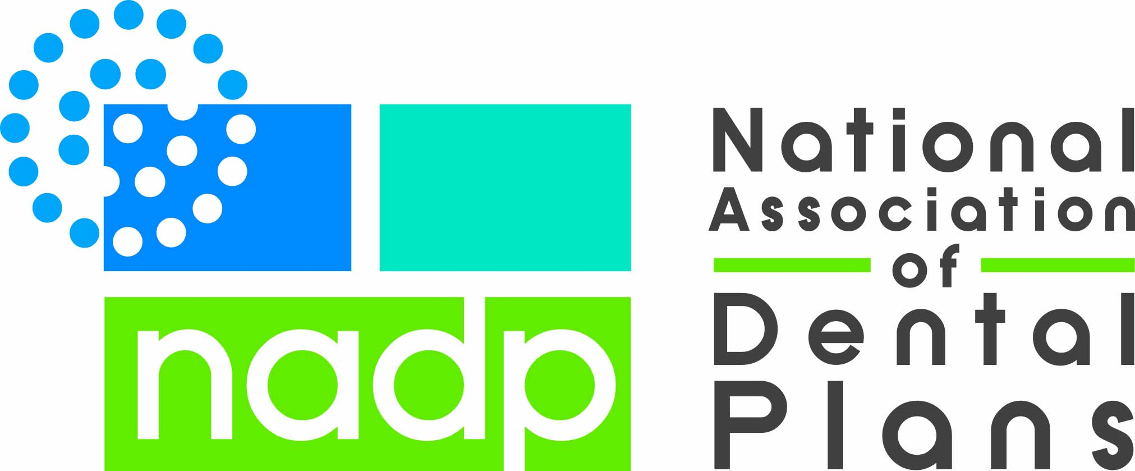
Exploring Paths for Dental Integration and Coordinated Care
January 2019 AIDPH Colloquium
Evolving the Dental Public Health Landscape
Interprofessional Practice and Value-Based Care
Notes:
Thank you for having me participate. I have to say that at first I wondered why I was invited. As the executive for the trade association for the dental benefits industry, I see things much more at the 10,000 foot level and more from the commercial side of the market than from the public benefit side. But, as I sat through presentations yesterday, I realized that NADP has data and perspective that answers some of your questions and can be helpful in the systems change your are interested in fostering.
As well, I have learned from being here and can translate some of that into education for the dental benefits industry more broadly that can also be helpful

Slide 2
NADP’s Mission
To promote and advance the dental benefits industry to provide access to affordable, quality dental care
Notes:
Some of you have known me since I started with NADP when it was only capitated plans and known as the National Association of Prepaid Dental Plans. In my 27 years as Director there has been change and focus, so just a bit about NADP.
Our mission is to…
It is probably not surprising that a public health dentist on our Board in the 90s helped us craft this mission. I point it out to staff and members all the time. We are not just about the status quo; we are supposed to be helping the industry to evolve.

Slide 3
NADP Programs & Services
Government Relations
  State & federal legislative & regulatory tracking, comments & lobbying
  Proactive initiatives
Research
  Industry benchmarks
  Employer concerns/interests
  Consumer concerns/interests
  Specialized snapshots of a particular practice
Education & Communication
  Industry Conferences & webinars
  Presentations to Others
  Voice of the dental benefits industry to press and policymakers
Collaboration on Terminology, Standards, & Transactions
  X12 & HL7
  SNOMED
  DQA
  CMC
  DeCC
  SCDI
  DeCFAC
  WEDI
Notes:
Next week we have our leadership conference, so I have been looking at a lot of our organizational documents. It is probably clear that NADP does government relations, research and education for and about the industry. What I realized might be helpful to this group is to know more about the work we do on terminology, standards and transactions.
NADP has a voting role on every standard setting body that impacts dentistry and the benefits. From the group overseeing CDT, to EDI, to claim forms, quality measures and diagnostic codes, we have staff and volunteers that participate.
Given that IT, diagnostic codes and quality measures came up as critical in the movement to interdisciplinary care, I have added some updates from this area of our work to this presentation. So there will be some things in the slide deck that I will hit at a very high level, so I can get to the answers to some of the questions you asked yesterday.

Slide 4
Learning Objectives
Create a basic understanding of the dental benefits market and the impediments and opportunities it creates for dental/medical integration
Share key findings of studies of dental treatment impacts on key medical costs in both the private and public sector.
Discuss expansion of dental benefits in public programs as well as opportunities and risks for continuation of that coverage.
Explore potential changes in the private market that could expand or supplement care delivery for public programs.
Notes:
So you’ve seen the learning objectives in your materials, let’s start

Slide 5
Dental Enrollment Trends
Notes:
Let’s start with dental enrollment trends

Slide 6
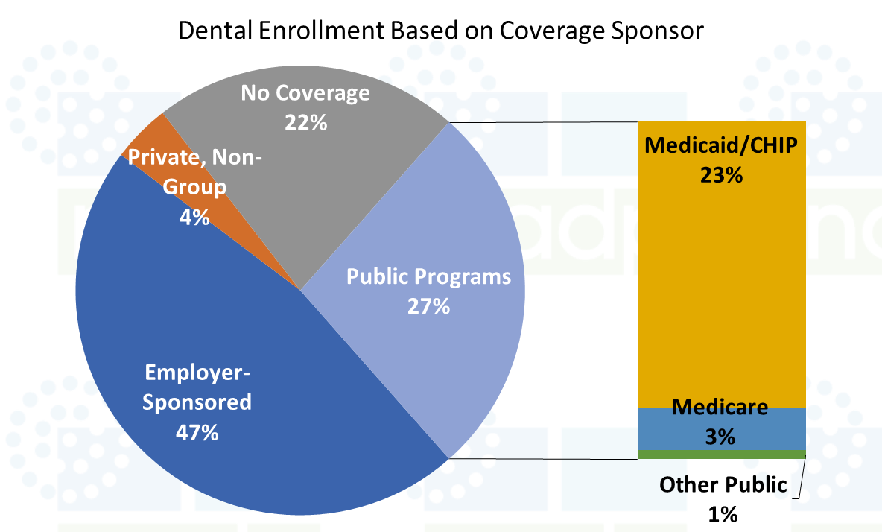
2017 Sources of Dental Coverage
Only 22% of Americans have no dental benefits.
A little more than half of the population gets dental benefits in the private market—through employers or by purchasing as an individual.
Just over a quarter of the population gets dental benefits through a public program.
About 4% of the population has individual coverage for dental services.
SOURCE: NADP 2018 Dental Benefits Report: Enrollment
Notes:
As of 2017 only 22% of Americans don’t have dental benefits. This is a significant reduction in the uninsured without a mandate for coverage. What happened?
While just over half the population gets dental benefits in the private market—primarily through employer groups, more than a quarter of the population now gets benefits through publicly funded programs. The combination of expansion of Medicaid benefits under the ACA in most states coupled with recent additions of some level of adult dental services in Medicaid is the largest portion. But growth in Medicare Advantage plans that cover dental is a large part as well.
About 1/3 of those without coverage are seniors and the rest are either working for employers that don’t offer dental benefits (usually small employers) or are low income individuals in states that have not expanded Medicaid or added dental services under Medicaid.
FYI—The private, non-group category just means individual purchases.

Slide 7
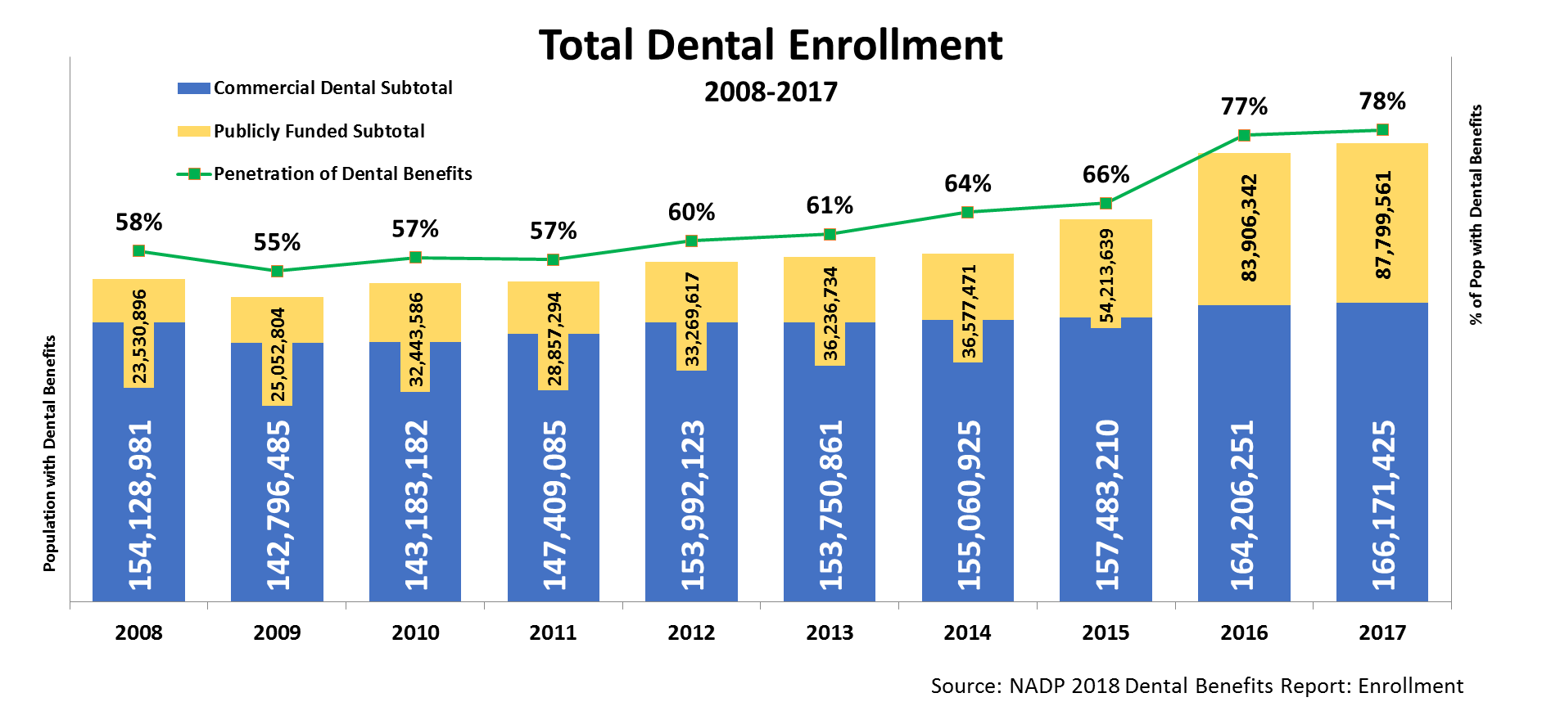
National Dental Enrollment
Notes:
This how the trend in dental benefits looks over time. You can see that coverage hovered in the 60% range until the ACA was implemented in 2014; then larger increases began.
Some of the change is not actual year to year jumps but better data, but I’ll explain that as I go along.

Slide 8
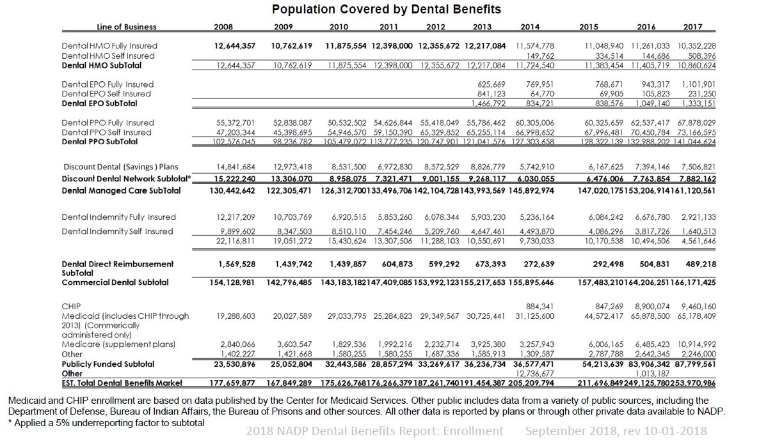
Notes:
The big expansion of the population with access to dental benefits is in public programs.
Between 2014 and 2017, the population with dental benefits through Medicaid more than doubled while the population with dental benefits through MA programs tripled!
CHIP enrollment also increased substantially.

Slide 9
Impacts of Oral Health on Overall Health

Slide 10
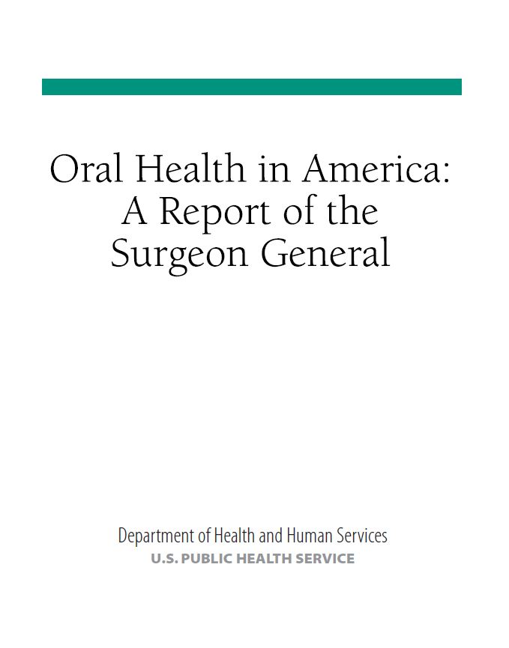
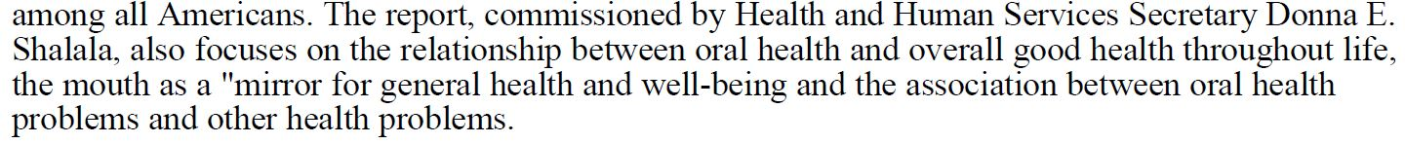
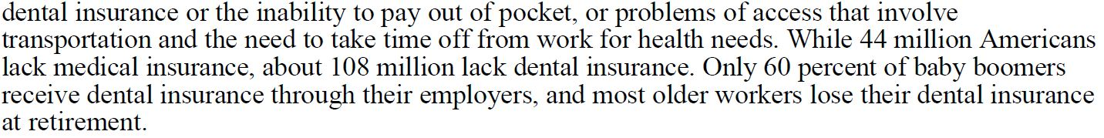
Notes:
In many ways the Surgeon General’s Report on Oral Health in 2000 changed the way we talked about oral health. It connected oral and overall health starting a new and broader dialogue.

Slide 11
Why are the links important?
47.2% of adults aged 30 years and older have some form of periodontal disease ¹
Periodontal disease increases with age, 70.1% of adults 65 years and older have periodontal disease ¹
The United States preterm birth rate of 9.6% equates to an economic burden of at least $26.2 billion in direct and indirect costs. ⁴
More than 29 million Americans are living with diabetes, and 86 million (more than a third of American adults) are living with prediabetes. The total estimated direct and indirect cost of diagnosed diabetes in 2012 was $245 billion ²
About 92.1 million American adults are living with cardiovascular disease or the after-effects of stroke. Direct and indirect costs of cardiovascular diseases and stroke are estimated to total more than $316 billion ³
¹https://www.cdc.gov/oralhealth/conditions/periodontal-disease.html June, 2016
²https://www.cdc.gov/chronicdisease/resources/publications/aag/diabetes.htm July, 2016
³https://www.heart.org/idc/groups/ahamah-public/@wcm/@sop/@smd/documents/downloadable/ucm_491265.pdf January, 2017
⁴http://www.midwife.org/acnm/files/ccLibraryFiles/Filename/000000006389/MillionBabiesWhitePaper112916.pdf 2016
Notes:
The connections between oral and overall health became more important because of links to chronic and high cost medical conditions.
This slide is from one of our webinars about the linkages particularly to preterm births, diabetes, cardiovascular disease and stroke.

Slide 12

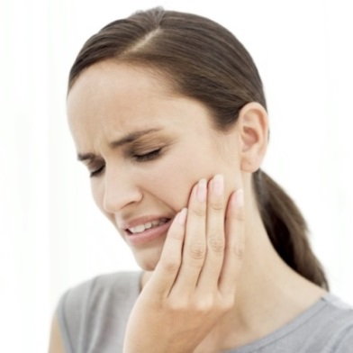
Chronic Disease Study Overview
The study used data from 2005-2009 to analyze 1.7MM people,
~91,000 of which were diabetic patients with periodontal disease
In patients with periodontal disease, the study compared
primary outcomes including:
  Medical costs
  Number of Medical Visits
  Number of Hospital Admissions
Patients who received treatment and were maintained
VS.
Patients who
remained untreated
Notes:
Even before the Surgeon General’s Report commercial carriers were doing studies on connections. United Concordia has done a number of in depth ones.

Slide 13
Conclusions: Total Medical Costs
Condition |  | Annual Total Medical Costs Per Subject
 |  | Periodontal Disease |  | Difference |  | Significance
 |  | Untreated | Treated
Type 2 Diabetes (T2D) |  | $7,056 | $4,216 | $2,840 | (40.2%) | P<0.04
Cerebral Vascular Disease (CVD) |  | $13,895 | $8,214 | $5,681 | (40.9%) | P<0.04
Coronary Artery Disease (CAD) |  | $10,222 | $9,133 | $1,089 | (10.7%) | Varies by Year
Rheumatoid Arthritis (RA) |  | $9,218 | $8,637 | $581 | (6.3%) | No
Pregnancy and Delivery | First Instance | $3, 299 | $866 | $2,433 | (73.7%) | P<0.001
 | Second Instance | $3,301 | $1,754 | $1,547 | (46.9%) | No
Source: Jeffcoat, M., et. al., Periodontal Therapy May Improve Outcomes in Specific Systemic Conditions; Evidence From Insurance Claims. Abstract, American Association of Dental Research, March 22, 2014
Jeffcoat MK, Jeffcoat RL, Gladkowski PA, Bramson JB, Blum JJ. Impact of Periodontal Therapy on General Health: Evidence from Insurance Data for Five Systemic Conditions, American Journal of Preventive Medicine, 47(2014) pp. 166-174. DOI: 10.1016/j.amepre.2014.04.001
Notes:
They looked at medical costs per member by disease

Slide 14
Conclusions: Inpatient Hospital Admissions
Condition |  | Annual Inpatient Admissions per 1000 Subjects
 |  | Periodontal Disease |  | Difference |  | Significance
 |  | Untreated | Treated
Type 2 Diabetes (T2D) |  | 66.625 | 40.350 | 26.283 | (39.4%) | P<0.05
Cerebral Vascular Disease (CVD) |  | 444.425 | 350.000 | 94.433 | (21.2%) | P<0.02
Coronary Artery Disease (CAD) |  | 65.225 | 46.575 | 18.653 | (28.6%) | P<0.001
Rheumatoid Arthritis (RA) |  | 142.650 | 136.275 | 6.383 | (4.5%) | No
Pregnancy and Delivery | First Instance | Not Applicable
 | Second Instance
Source: Jeffcoat, M., et. al., Periodontal Therapy May Improve Outcomes in Specific Systemic Conditions; Evidence From Insurance Claims. Abstract, American Association of Dental Research, March 22, 2014
Jeffcoat MK, Jeffcoat RL, Gladkowski PA, Bramson JB, Blum JJ. Impact of Periodontal Therapy on General Health: Evidence from Insurance Data for Five Systemic Conditions, American Journal of Preventive Medicine, 47(2014) pp. 166-174. DOI: 10.1016/j.amepre.2014.04.001
Notes:
And hospitalizations as well

Slide 15
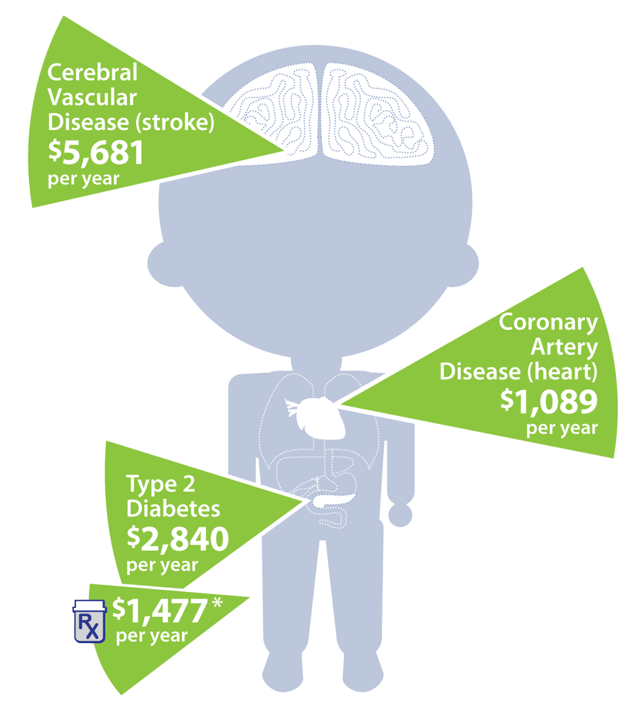

Chronic Disease Savings
$2,433 on costs associated with the mother’s medical treatment prior to delivery of her
first baby.
Notes:
They reported their findings in annual medical cost savings. And they are significant given the scope of these medical conditions.

Slide 16

Aetna-Columbia Study Results:
Retrospective Claim Analysis, Chronic Conditions
Episode Risk Group™ (ERG) scores for Diabetes, CAD & CVD participants
ERG™ is a
Modeling tool
to predict
current and
future health care utilization
ERG™ Risk Scores | Periodontal Services Risk Score | No Dental Services Risk Score | Reduction in Risk Score
Diabetes | 3.39 | 4.79 | 29.2%
Coronary Artery Disease (CAD) | 4.68 | 6.49 | 27.9%
Cerebrovascular Disease (CVD) | 6.23 | 8.26 | 24.6%
An examination of periodontal treatment and per member per month (PMPM) medical costs in an insured population BMC Health Services Research, David Albert, Donald Sadowsky, Panos Papapanou Mary Conicella, Angela Ward BMC Health Services Research 2006 DOI: 10.1186/1472-6963-6-103
Notes:
Aetna and Columbia looked at similar conditions but reported findings in reduction in risk scores

Slide 17
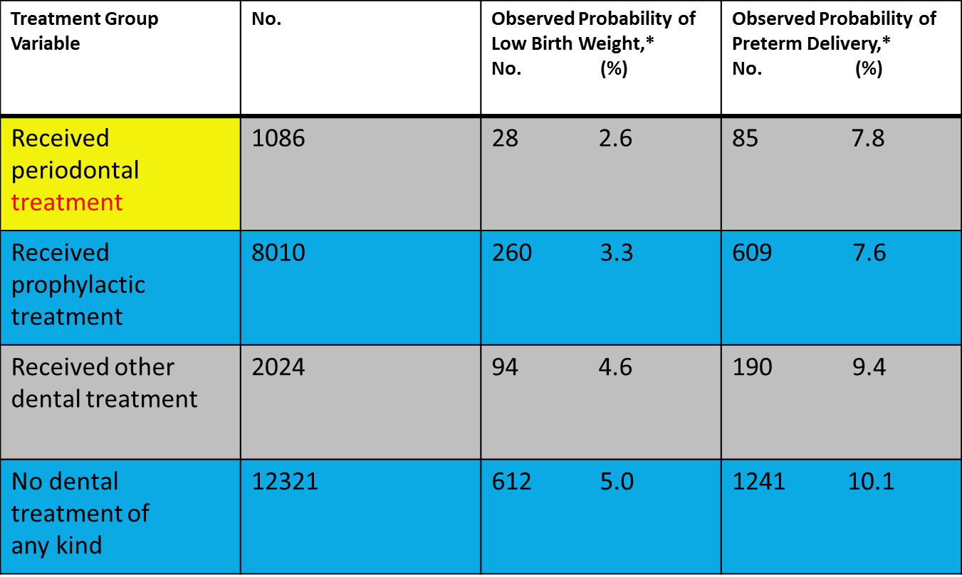
Aetna-Columbia Study Results:
Retrospective Claim Analysis, Pregnancy
*P < .001
Examination of Periodontal Treatment, Dental Care, and Pregnancy Outcomes in an Insured Population in the United States. Albert, D. A., Begg, M. D., Andrews, H. F., Williams, S. Z., Ward, A., Conicella, M., … Papapanou, P. (2011). An American Journal of Public Health, 101(1), 151–156. http://doi.org/10.2105/
Notes:
Here’s their data on pregnancy outcomes.

Slide 18
Aetna 2017 Study Results
Heart Disease/Hypertension & Diabetes
Members with dental care have…
5% lower medical claim costs
20% fewer inpatient admissions
Better HbA1c, Cholesterol and Triglyceride results
² 2017 Statistically valid study of Aetna clients with continuous dental coverage from 2013 through 2015 with and without Dental Care. Client demographics in age, gender, geography, risk score, dental & medical plan design and comorbidities were nearly identical.
Notes:
And on heart disease and hypertension

Slide 19

Kaiser Permanente Research: Description
Results:
Compared to those who did not receive regular dental care, those who did, were statistically significantly more likely to have:
Good control of HbA1C levels
Lower diabetes-specific ED utilization
Lower diabetes-specific hospital admissions
Disease Management/Care Delivery
Population Characteristics:
Population Characteristics | Dental (N=493) | Non-Dental (N=493) | P-value
Age (Mean) | 61.4 | 61.3 | 0.94
White (%) | 86.0 | 88.0 | 0.53
Diabetes Control (%) | 54.8 | 43.2 | <0.001
Perio Risk (Elevated) (%) | 20.7 | 25.8 | 0.06
1+ ED visit in 2007 (%) | 10.1 | 16.2 | 0.005
1+ Hospital admission in 2007 (%) | 8.3 | 14.8 | 0.001
Health/Wellness Prevention
Medical + Dental
BETTER TOGETHER
Notes:
Kaiser has done similar studies which Dr. Snyder may reference, but their data adds more credibility to the story of cost savings. In our 2017 webinar they presented this data on impacts of dental treatment on diabetes.

Slide 20
Kaiser Permanente Research: Results
After adjusting for other factors, regular receipt of dental care across a three-year period was independently associated with:
39% (statistically significant) decrease in odds of diabetes-specific ED utilization.
39% (statistically significant) decrease in odds of diabetes-specific hospital admissions.
29% increase in odds of HbA1C control.
Disease Management/Care Delivery
Regular dental care is associated with lower utilization of healthcare
Health/Wellness Prevention
Medical + Dental
BETTER TOGETHER

Slide 21
Kaiser Permanente Research
Disease Management/Care Delivery
Periodontal interventions associated with healthcare cost savings
Health/Wellness Prevention
Medical + Dental
BETTER TOGETHER

Slide 22
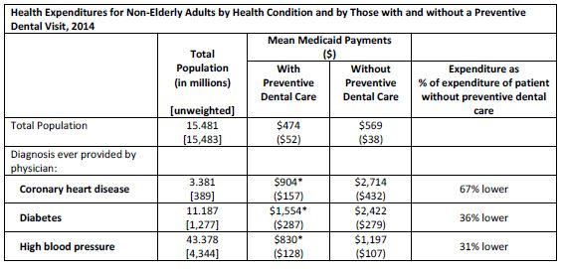
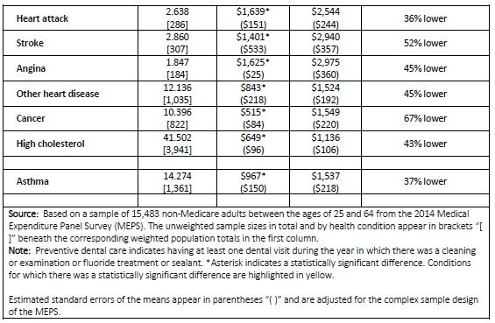
Impact of Medicaid Preventive Dental on Medical Costs
SOURCE: NADP Commissioned Study by the University of Maryland of MEPS data, Released Nov. 2017.
Notes:
In 2017, with the discussions about restructuring Medicaid payments and the increasing flexibility in waivers, we began to wonder if there was any data that would show similar results for public programs. So we commissioned an analysis of MEPS data by Dr. Manski and his colleagues at Univ. of MD. Looking at the first year of Medicaid expansion, we found that patients in Medicaid with dental preventive treatment had similar lower medical costs.
One year of data is not enough, so Columbia is replicating this analysis and expanding the number of years analyzed. Assuming that we find the same results year over year, we plan to work with them to publish a Journal article for use in promoting and defending adult dental care in Medicaid.

Slide 23
Employer Attitudes about Dental Benefits
Source: NADP 2018 Survey of Employers
Notes:
These studies and many more that have been promoted by insurers and covered in the press have convinced employers that dental benefits are essential or a differentiator.
More than half of all employers believe dental benefits are an essential component of an employee benefits package. And that has not changed over the past 5 years.

Slide 24
Employers Offering Dental Benefits to Full Time Employees
Source: NADP Surveys of Employers
Notes:
However, the uncertainties and higher costs resulting from the ACA have pushed employers to drop dental benefits.
Fewer consumers have access to dental benefits through work than when the ACA passed. Because most of the change is in smaller employers, this has not eroded the overall number of those insured in the private market, but has shifted coverage to larger employers.

Slide 25
Dental Growth in Public Programs
Notes:
So the growth in Americans with access to dental coverage has been in public programs

Slide 26
Key Dental Growth Segments
Medicaid
Eligibility | Enrollment | Funding
Historically, provided coverage to certain categories of people (e.g., low-income children, pregnant women, poor elderly) ACA expanded eligibility to include low-income adults | About 73 million individuals covered as of Oct 2018 (not all have access to dental services and level of services available vary by state) 16.3 million (22%) of those were newly receiving coverage since October 2013 | Jointly funded by the federal government and states States receive a percentage of matching federal funds from the federal government
ACA: Affordable Care Act; CMS: Centers for Medicare & Medicaid Services
Sources: CMS Medicaid & CHIP: February 2018 Monthly Applications, Eligibility Determinations and Enrollment Data. New enrollment in non-expansion states is largely expected to be due to the “woodwork effect,” but data reporting errors could distort these figures. This analysis compares monthly Medicaid enrollment reported through February 28, 2018, to monthly enrollment reported from the July-September 2013 time period.
Notes:
65M of 73M under Medicaid programs have dental benefits. There is still room for substantial growth within the program itself with both the addition of dental coverage and expansion.

Slide 27
Contribution to Dental Growth
ACA Medicaid Expansion States
WA
ME¹
MT
ND
OR
VT
MN
NH
ID
SD
WI
NY
MA
WY
MI
CT
PA
RI
NE
IA
NJ
NV
IL
IN
OH
DE
CA
UT
WV
MD
CO
MO
VA
D.C.
KS
KY
Path to More Expansion
Maine passed a referendum to expand Medicaid on November 7, 2017 but the state has not yet implemented expansion. New Gov. elected Nov 2018 will implement.
VA passed expansion in May 2018 with 2019 implementation
Idaho, Nebraska and Utah passed 11/18 ballot initiatives to expand.
Election of Democratic Governors in Nov 2018 improves chances of expansion in Kansas and Wisconsin
ACA: Affordable Care Act
Original SOURCE: Avalere State Reform 360; updated by NADP Jan 2019 (see notes at right)
NOTE: Eligibility adjustment states do not count as expansion states and do not receive the enhanced ACA federal matching rate.
NC
OK
TN
AZ
NM
AR
SC
MS
AL
GA
TX
LA
AK
FL
HI
Expanded Eligibility (36 + DC; more activity expected in 2019)
Eligibility Adjustment (UT moved from this category after 2018 election. WI remains)
Movement Toward Expansion (expected in Gov budget in March)
Not Expanding (14 could be reduced in 2019)
Notes:
When Medicaid expansion happens in a state with adult dental benefits under Medicaid, access to adult dental benefits expands.
With the referendums on Medicaid expansion in the 2018 elections, there are now 36 states and DC that have expanded Medicaid. And the changes of Governor in a couple of states offers a path for more expansion this year.

Slide 28
Key Dental Growth Segment
Medicaid—Adult Coverage by State
WA
MT
ME
ND
OR
VT
MN
NH
ID¹
SD
WI
NY
MA
WY
MI
CT
PA
RI
NE
IA
NJ
NV
UT
IL
IN
OH
DE
CA
CO
WV
MD
KS
MO
VA¹
D.C.
KY
Idaho provides extensive dental coverage to adults with disabilities and other special health care needs; all other adult members receive emergency only benefits.
Virginia provides extensive dental benefits to pregnant women.
Arizona provided extensive benefits to persons with disabilities effective October 1, 2016.
Hawaii is expanding adult dental benefits from emergency to basic in 2019.
TN
NC
AZ¹
NM
OK
AR
SC
MS
AL
GA
TX
LA
AK
FL
Source: Nov 2018 CHCS Medicaid Adult Dental Benefits: An Overview
HI
Extensive (18 + DC)
Limited (17)
Emergency (12)
None (3)
Notes:
States are increasing adult coverage under Medicaid. In the past several years. This is the most updated map for coverage of adults under Medicaid.
18 states and DC have “extensive” benefits. 17 have limited and a dozen have “emergency only.”

Slide 29
Key Dental Growth Segments
Medicaid
Categories of Medicaid Adult Dental Benefits
Extensive A more comprehensive mix of services, including many diagnostic, preventive, and minor and major restorative procedures. It includes benefits that have a per-person annual expenditure cap of at least $1,000. It includes benefits that cover at least 100 procedures out of the approximately 600 recognized procedures per the ADA’s Code on Dental Procedures and Nomenclature | Limited A limited mix of services, including some diagnostic, preventive, and minor restorative procedures. It includes benefits that have a per-person annual expenditure cap of $1,000 or less. It includes benefits that cover less than 100 procedures out of the approximately 600 recognized procedures per the ADA’s Code on Dental Procedures and Nomenclature
Emergency Relief of pain and infection. While many services might be available, care may only be delivered under defined emergency situations | None No Dental Benefit
Notes:
Definitions of categories

Slide 30
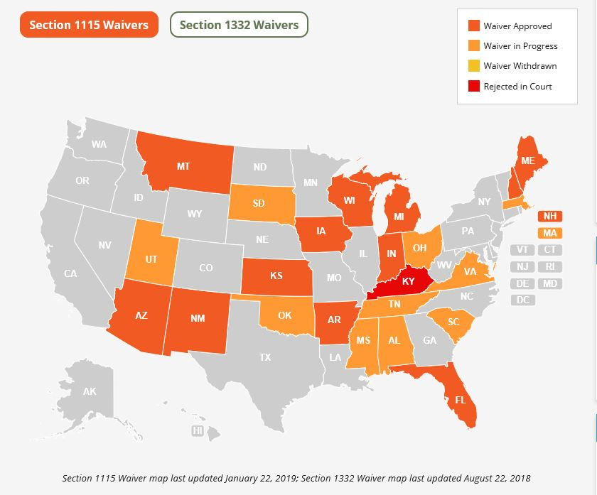
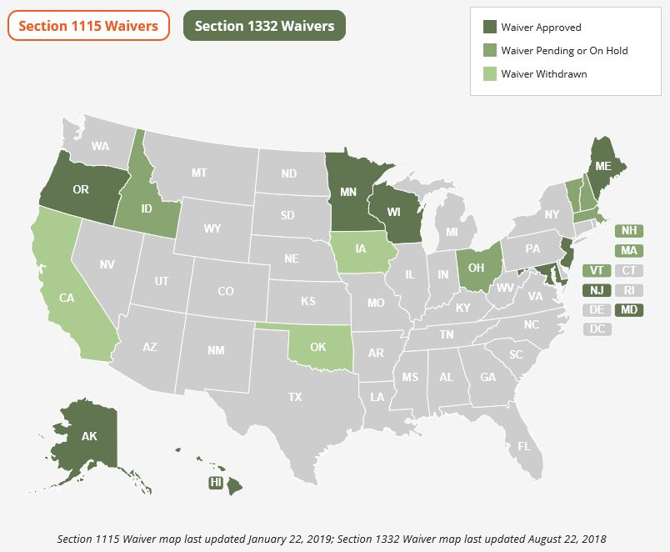
Challenges to Medicaid Expansion
SOURCE: Families USA Waiver Strategy Center, accessed 1/22/2019
Notes:
Medicaid is the largest public program with the most potential to coordinate delivery of care and show impacts for the costs of care.
Putting work requirements or otherwise restructuring under the Trump administration’s openness on waivers is a threat to the gains of coverage that have been made in the past several years.
Families USA has a tremendous strategy center on waiver activity with resources on how to oppose them.

Slide 31
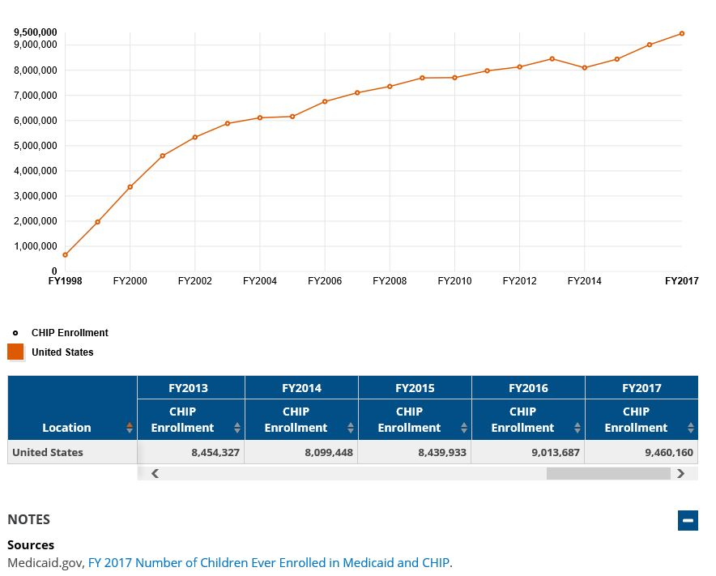
Contribution to Dental Growth-- CHIP
Accessed on KFF on 1/22/2019
Notes:
Recent Congressional funding of CHIP through 2023 means longer term stability for children’s dental coverage.

Slide 32
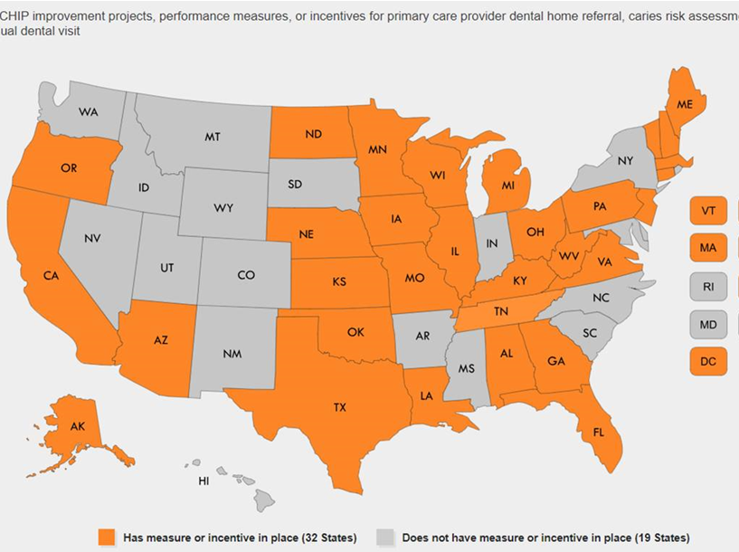
National Academy of State Health Policy, January 2019 Publication of State Strategies for Promoting Children’s Preventive Services.
Maps and charts illustrate state-specific Medicaid or CHIP performance improvement initiatives that promote children’s preventive services, including those recommended by the American Academy of Pediatrics’ Bright Futures guidelines.
Notes:
And, as this study by the National Academy of State Health Policy that was just releases this week shows, there are many measures in place for children’s coverage in Medicaid and CHIP. Hopefully the funding stability will allow for more.

Slide 33
Key Dental Growth Segment
Medicare Advantage
MA AS % OF TOTAL MEDICARE ENROLLMENT
Source: Medicare Baseline Estimates. Congressional Budget Office. January 2017. Available here.
Notes:
There actually is a fair amount of growth in the MA arena as well.
Medicare Advantage products are currently just over 1/3 of all Medicare enrollment for those over 65. By 2027, they are expected to cover 40% of enrollees.

Slide 34
Medicare Advantage Dental Offerings
Percent of MA plans and percent of enrollment by dental coverage type at the national level, 2017
Source: Avalere Health analysis using enrollment data released by the Centers for Medicare & Medicaid Services. The analysis uses enrollment files released in February of each year, from 2015 through 2017, reflecting enrollment effective in January of each respective year. *Includes HMO, local PPO, regional PPO, and PFFS plans
Notes:
Most MA plans include some level of dental benefits. Mandatory benefits are value adds paid for by star rating funds and provided to ever member of an MA plan. The Optional have a premium attached.

Slide 35
Distribution of Dental
Medicare Advantage
PERCENT OF MA PLANS OFFERING MANDATORY OR OPTIONAL DENTAL BENEFIT, 2017
WA
ME
MT
ND
OR
VT
MN
NH
ID
SD
WI
NY
MA
WY
MI
CT
PA
RI
NE
IA
NJ
NV
UT
IL
IN
OH
DE
CA
CO
WV
MD
KS
MO
VA
DC
KY
TN
NC
AZ
NM
OK
AR
SC
70%-80% (3)
MS
AL
GA
60%-69% (8)
LA
50%-59% (15 + DC)
TX
AK
40%-49% (13)
FL
30%-39% (8)
HI
0%-10% (3)
Notes:
The percentage of MA plans offering dental benefits varies widely by state. Interestingly higher in the South and East.

Slide 36
MA Dental Enrollment
PERCENT OF ENROLLEES IN AN MA PLAN WITH MANDATORY OR OPTIONAL DENTAL COVERAGE, 2017
WA
ME
MT
ND
VT
OR
MN
NH
ID
SD
WI
NY
MA
WY
MI
CT
PA
RI
NE
IA
NJ
NV
IL
IN
OH
DE
CA
UT
WV
MD
CO
VA
DC
KS
MO
KY
TN
NC
AZ
NM
OK
AR
SC
MS
AL
GA
80% or More (11 + DC)
TX
LA
60%-79% (15)
AK
40%-59% (16)
FL
30%-39% (5)
HI
5% or Fewer (3)
Notes:
And enrollment in MA plans with dental benefits doesn’t perfectly track the states with the highest offerings.

Slide 37
Dental Services Vary by MA Plan
PERCENTAGE OF MA BENEFICIARIES WITH COVERED DENTAL SERVICES, 2015
Service Type | Total MA Beneficiaries Covered | Beneficiaries Covered with $0 Premium
Dental X-Ray | 58.1% | 48.6%
Oral Exam | 57.8% | 48.1%
Prophylaxis/Cleaning | 54.5% | 45.6%
Fluoride Treatment | 15.2% | 20.1%
Prosthodontics/Maxillofacial Surgery | 42.8% | 35.7%
Non-Routine Services | 19.5% | 21.7%
Diagnostic Services | 20.7% | 19.5%
Restorative Services | 31.1% | 26.6%
Endodontics/Periodontics/Extractions | 29.4% | 24.8%
SOURCE: Pope, Christopher. “Supplemental Benefits Under Medicare Advantage.” Health Affairs. January 21, 2016. Available here.
Notes:
Services covered under MAP plans varies from just preventive additions to more extensive benefits. Extensive benefits are those with additional premium

Slide 38
Dental Cost Sharing Varies by MA Plan
COST SHARING REQUIREMENTS FOR DENTAL SERVICES IN MA PLANS, 2017
Service Type | Percent of Plans with 0% Coinsurance | Range of Average Coinsurance* | Percent of Plans with $0 Copay | Range of Average Copay**
Preventive Services (i.e., X-Rays, Oral Exams, Cleaning) | 76% | 40%-45% | 70%-75% | Under $30
Diagnostic Services | 3% | 42% | 8% | $16-$26
Prosthodontics/ Maxillofacial Surgery | 0% | 60% | 16% | $21-$876
Restorative Services | 0% | 39%-53% | 23% | $25-$340
Endodontics/Periodontics/Extractions | 0% | 41%-51% | 18% | $21-$317
* Excluding plans with 0% coinsurance ** Excluding plans with $0 copay
SOURCE: Avalere Health analysis using enrollment data released by the Centers for Medicare & Medicaid Services. February 2017. Includes HMO, local PPO, regional PPO, and PFFS plans.
Notes:
Out of pocket costs for MA plan enrollees also varies widely

Slide 39
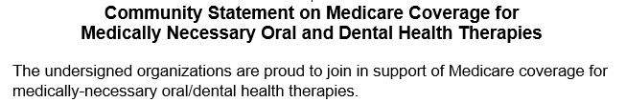
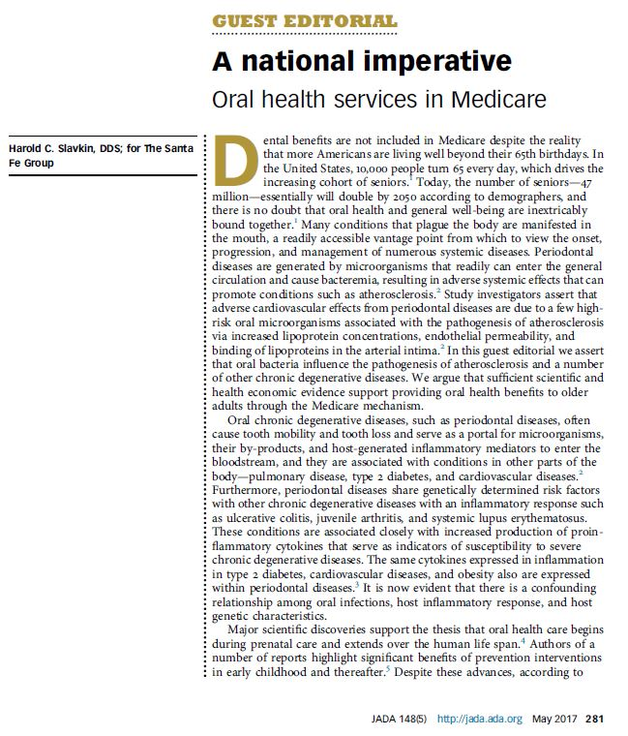
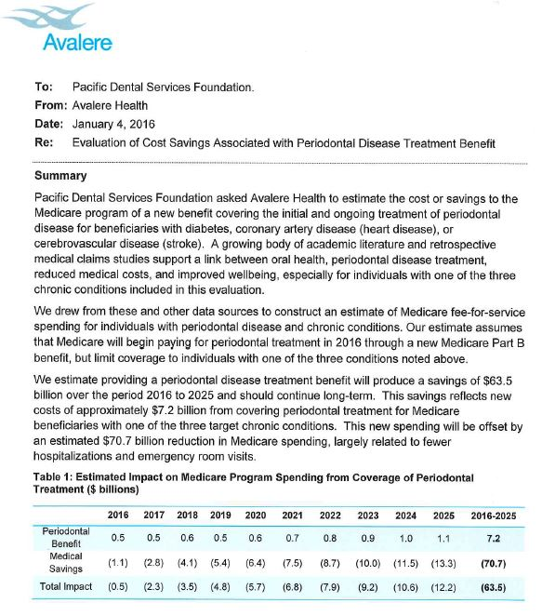
Expansion of Dental in Medicare
Medicare Part B
$63.5 billion in savings over 10 years
Notes:
One of the speakers asked yesterday if a framework is being put in place for broader inclusion of dental in Medicare. It is.
Pacific Dental Services, a DSO funded a study that shows that a $7.2B investment in Medicare periodontal benefits will net $63.5B in savings in medical costs in that same period for the program.
This is being discussed not just in the oral health world, but the Congressional Budget Office, which has to cost such proposals has reached out to key researchers in this arena to discuss the data. So there is more work happening than you see on the surface.

Slide 40
Challenges and Opportunities in Dental-Medical Integration

Slide 41
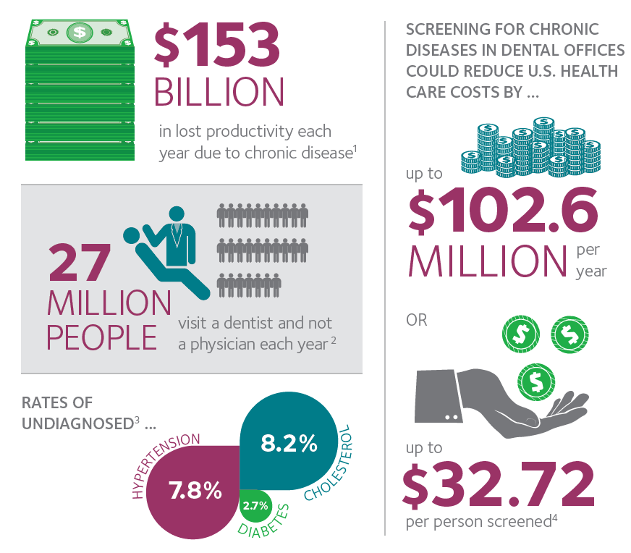
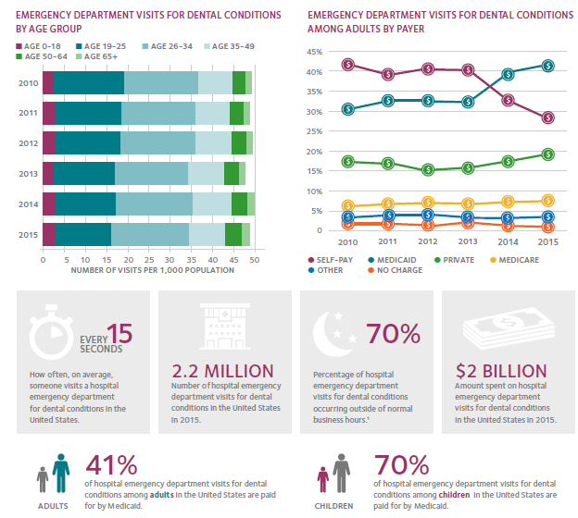
The Dental Value Proposition:
Scope of Economic Impact
Notes:
It is no secret to this group that dental both contributes to medical costs through emergency room visits, but could contribute more to solutions with additional screenings and referrals to physicians.

Slide 42
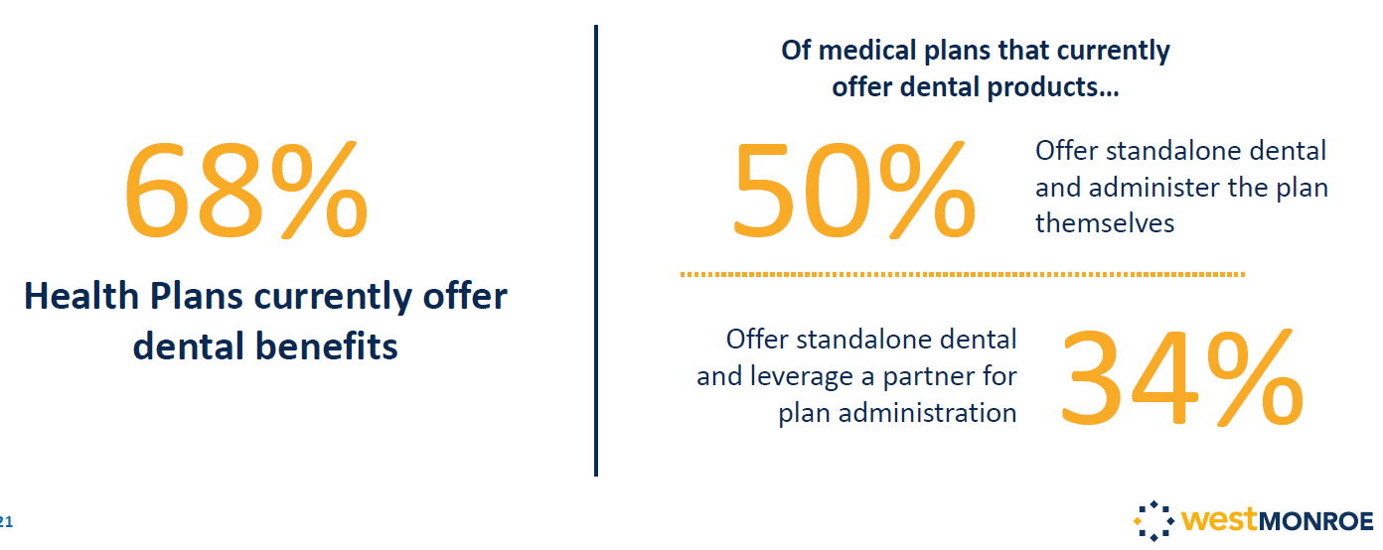
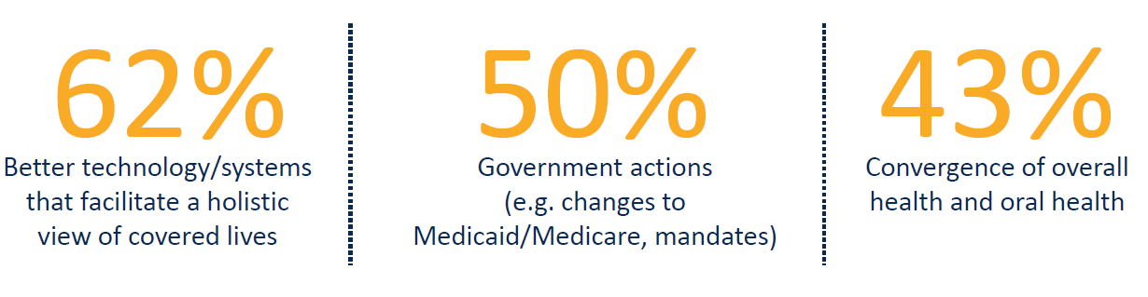
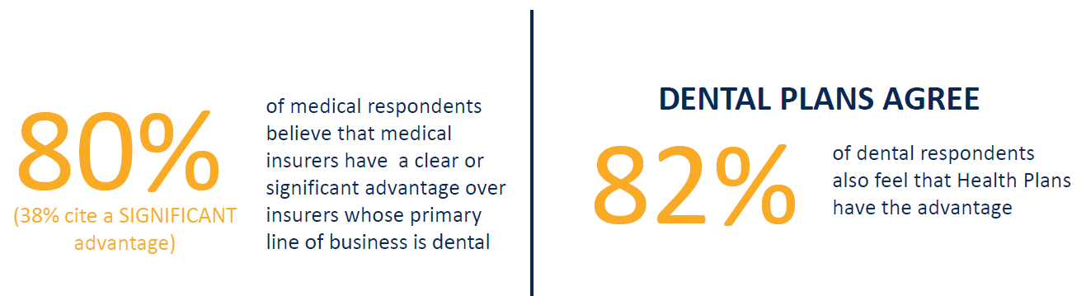
The Stage for Medical-Dental Integration
Majority of Health Plans offer dental benefits and intend to aggressively focus on ancillary
What are the three biggest factors that drive embedding of dental insurance into health insurance
When it comes to beliefs on who has the advantage in the dental benefit market…
Notes:
So, one of the questions you ask is when are insurance policies going to merge and help alleviate this situation.
We had a firm look at this issue for a session at our conference a few years ago. They found that medical carriers were going to aggressively move into dental, that the factors that will drive the change are improvements in technology, government mandates, and just overall convergence.
And both medical and dental insurers agreed that the medical carriers have the upper hand in merging the systems.

Slide 43
Commercial Dental Benefits Policy Structure
Notes:
But this is where the system stays today. Medical carriers are not putting adult dental benefits in policies. Dental benefits in medical policies are a blip in the overall market.
Not that does not mean that medical carriers are not aggressive in pushing dental coverage if they have a dental subsidiary or agreement. But they bundle with a discount on the medical coverage as they know their experience in savings by very specific geography.
But the separate delivery systems, the separate claim forms, the separate coding, etc. are too much for a medical carrier to take on itself with so many other competing priorities. So they leave it to their experts.

Slide 44
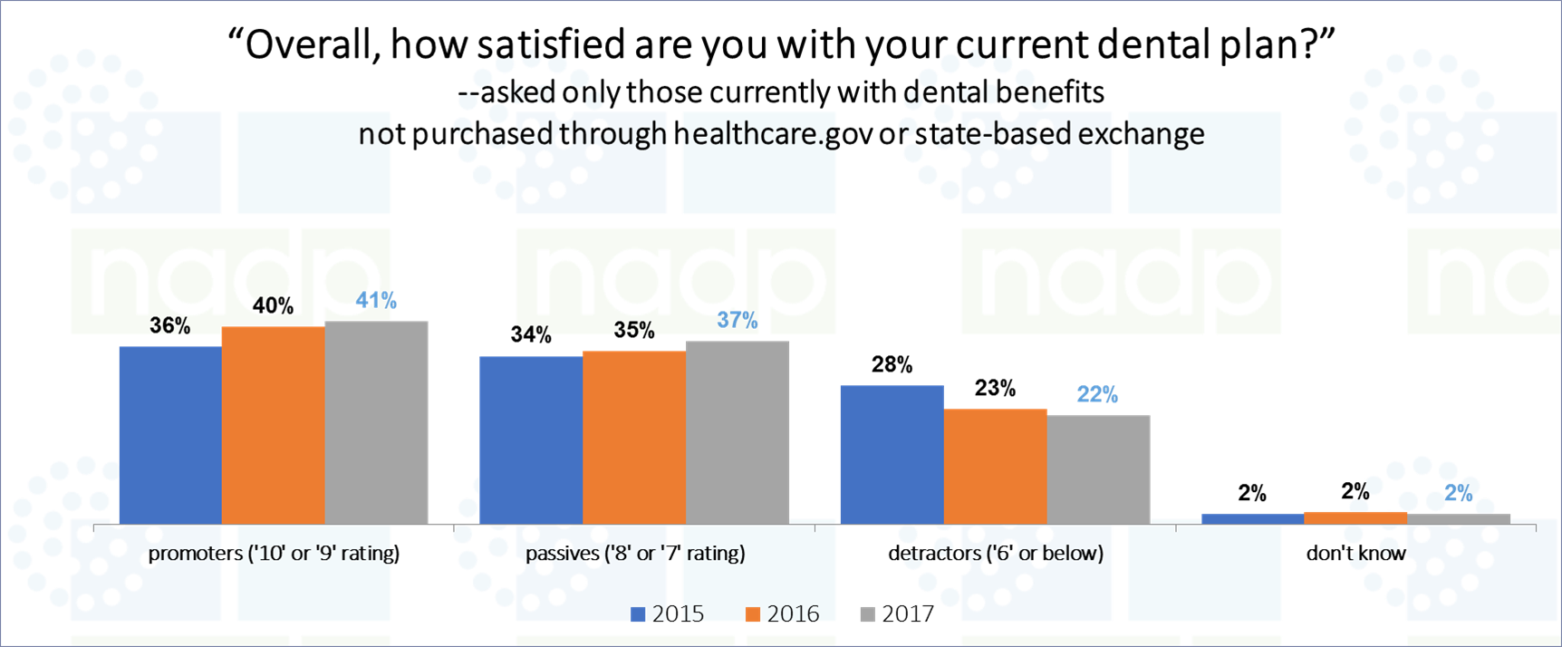
Consumer Attitudes about Dental Benefits
Source: NADP 2017 Survey of Consumers
Notes:
Consumers still highly value dental benefits. They are the most requested supplemental benefit beyond medical coverage.
They are largely satisfied with benefits structured separately and individual studies by the few plans that have embedded show lower utilization when embedded. So there would definitely be some education needed if benefits move that direction.

Slide 45
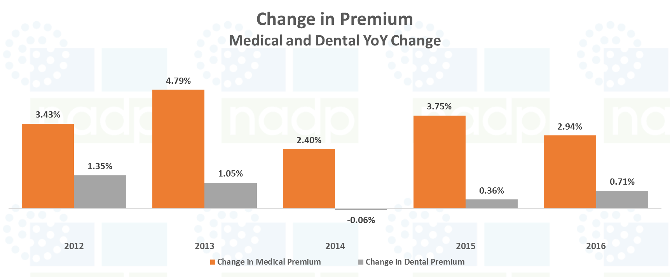
National Premium Trends
Source: NADP 2017 Premium, Benefit Utilization
and Benefit Design Trends Report
Notes:
One reason for satisfaction is that premiums are not going up and annual maximums are not hit by 95% of enrollees.
When you take into account inflation, the change in dental premium over the past several years is actually negative.
And compared to medical premium, premium changes are miniscual

Slide 46
National Dental Premium Funding Trends
Source: NADP 2018 Enrollment Report
Notes:
Even though more of the cost is being shifted to consumers and they are more often having to purchase their group coverage with no employer contribution, consumers remain satisfied with their dental benefits.

Slide 47
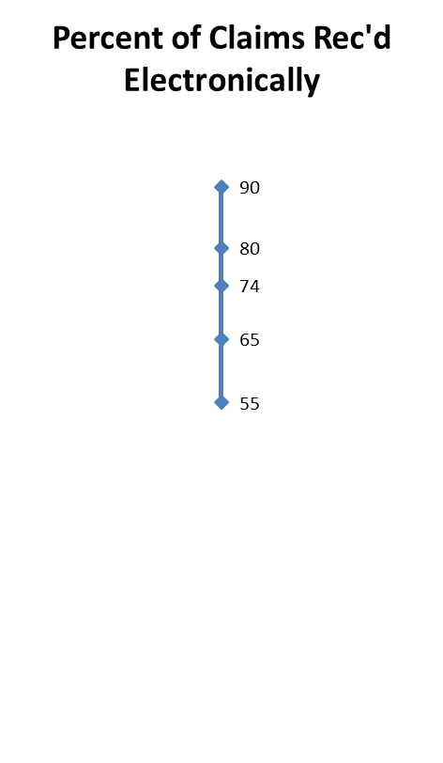
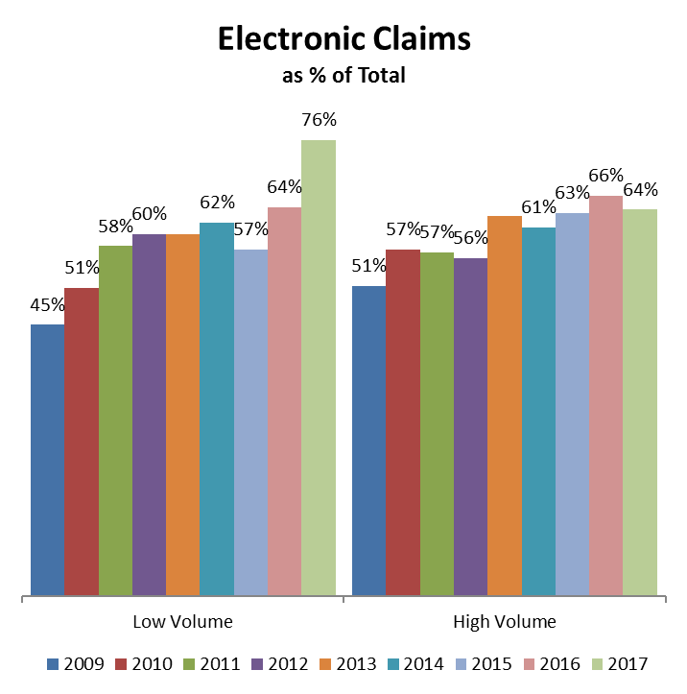
Electronic Claims
Compared to last year:
  The industry average (weighted, based on volume of claims) for electronic claims received increased from 66% to 70%.
  Low volume companies use of electronic claims increased from 64% to 76% of all claims.
Max
75th percentile
50th percentile
25th percentile
Min
NOTE: Data in this chart represents a weighted average based on the total number of claims reported. Not all respondents reported a total number of claims, so this chart represents a subset of the total number of respondents.
Notes:
We heard yesterday that one of the facilitators of interdisciplinary care is IT. This is another area where dentistry lags behind medical. Electronic claims which could facilitate transmission of diagnostic data are in mid 60% range.
Medical is XX
And dental claims is much higher than other forms of electronic transactions in dental.

Slide 48
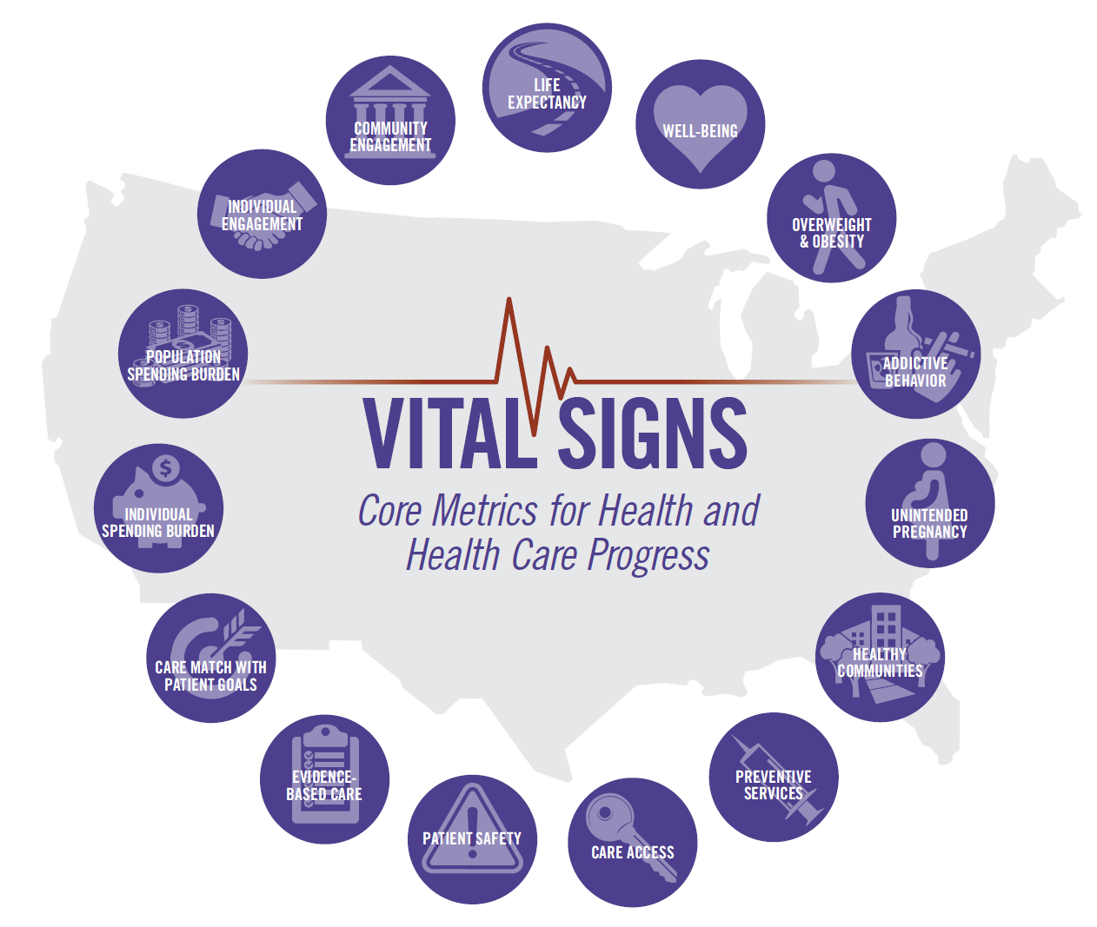
Excess administrative costs due to measurement and a range of
other activities are estimated at $190 billion per year, and continually expanding measurement activities and requirements could cause this figure to increase (IOM, 2012). All told, the
development and validation of measures; the collection, analysis, and maintenance of measurement data; and the reporting of measures have grown increasingly burdensome, with
significant financial impact.
IOM Vital Signs 2015
Notes:
With the low cost of dental and the limited resources for public programs, keeping added administrative costs for care delivery coordination, quality improvement and payment reforms is key.

Slide 49
DQA Administrative Claims Based Program and Plan Level Pediatric Measures
 | Measure Name
Evaluating Access and Utilization | Utilization of Services
 | Preventive Services for Children at Elevated Caries Risk
 | Treatment Services
 | Caries Risk Documentation
Evaluating Quality of Care | Oral Evaluation
 | Topical Fluoride for Children at Elevated Caries Risk
 | Sealants for 6–9 Year-Old Children at Elevated Caries Risk
 | Sealants for 10–14 Year-Old Children at Elevated Caries Risk
 | Care Continuity
 | Usual Source of Services
 | Ambulatory Care Sensitive Emergency Department Visits for Dental Caries in Children
 | Follow-Up after Emergency Department Visit by Children for Dental Caries
Evaluating Cost and Efficiency | Per Member Per Month Cost of Clinical Services
Notes:
You all know about DQA measures. NADP has been part of this group from the beginning and promotes use of these measures to plans.

Slide 50
DQA Administrative Claims Based Program and Plan Level Adult Measures
 | Measure Name
Evaluating Access and Utilization | Periodontal Evaluation in Adults with Periodontitis
Evaluating Quality of Care | Ongoing Care in Adults with Periodontitis
 | Topical Fluoride for Adults at Elevated Caries Risk
 | Oral Evaluation- Diabetics*
 | ED visits by Adults for Non Traumatic Dental Conditions*
 | Follow up after an ED visit by an Adult for Non Traumatic Dental Conditions*
*Currently under Testing

Slide 51
Use of DQA Measures
CMS CHIPRA Core Set (Public Reporting, QI)
Covered California – Health Benefit Exchange, Plan Contracts (QI)
MSDA: State Medicaid/CHIP Agencies Reporting Use
Michigan Healthy Kids Dental, Dental Plan RFP/Contract (QI)
Florida Medicaid, Dental Plan RFP/Contract (Public Reporting, QI)
Texas Medicaid and CHIP, Plan Contracts (Payment Program, Public Reporting, QI)
Massachusetts Delivery System Reform Incentive Payment, (Payment Program, Public Reporting, QI)
Oregon Health Authority (Payment Program, Public reporting, QI)
Quality Measures
Quality Improvement
Accountability
Policy
Research
Transparency (Public Reporting)
Reimbursement
Notes:
Many of our members still don’t know about the measures, so we continue with educations. Public programs have been better at use of these measures.
Someone said yesterday that DQA is involved in diagnosis code development, that is not the case. Some of the same staff at ADA is involved but that is not DQA’s role.

Slide 52

The Original EZCodes
1158 terms (1121 unique)
80 sub categories
13 major categories
Ongoing Revision
EZCodes 2011
1321 terms (1250 unique)
84 sub categories
14 major categories
SNODDS 2017
1729 terms (1477 unique)
SNODDS 2016
2015
1789 terms (1578 unique)
89 sub categories
17 major categories
EZCodes 2012
1358 terms (1284 unique)
90 sub categories
15 major categories
EZCodes 2013
1355 terms (1291)
89 sub categories
15 major categories
EZCodes 2014
1735 terms (1529 unique)
106 sub categories
17 major categories
202014
1714 terms (1518 unique)
106 sub categories
17 major categories
Notes:
On the question of when diagnosis codes are going to be required, I wanted to provide something of an update.
The first issue in diagnosis codes is that the ADA and dental schools developed separate systems.
After a lot of back and forth, these two systems were merged in 2017 into SNODDS.
So until 2017, there was not an agreed system for use. That’s very recent.

Slide 53
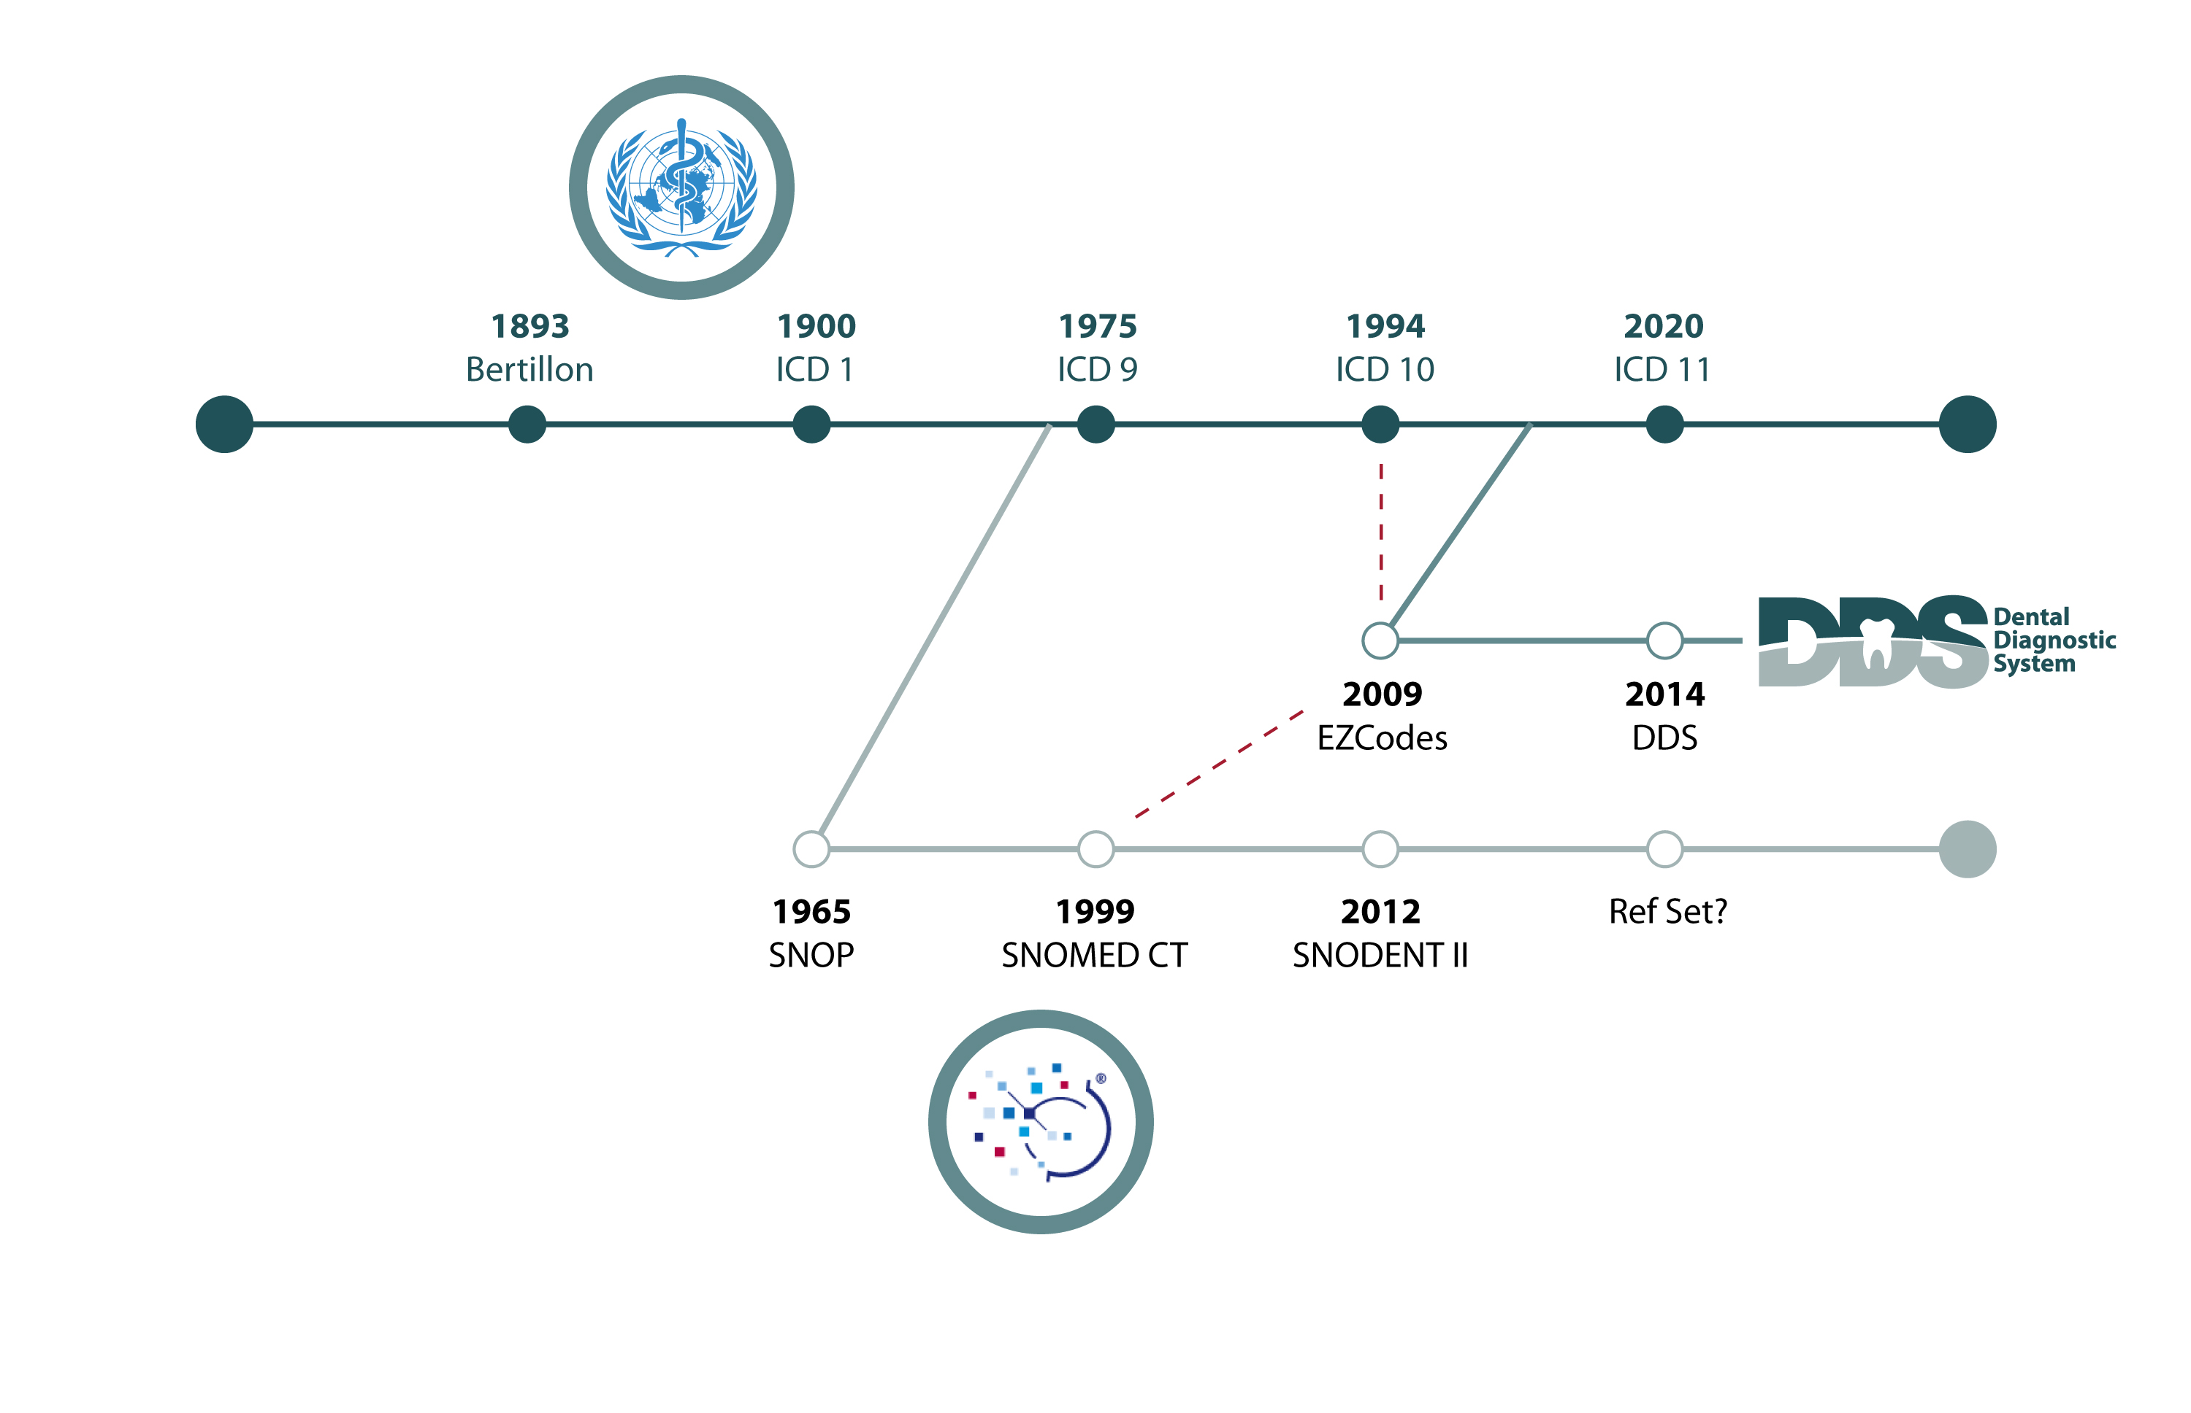

Z Codes
1999
1998
Toronto Codes
Refset
SNODDS
Notes:
However, there has been progress in getting these codes into a system that is used internationally by both medical and dental.
The ADA licenses SNODENT to what used to be called ITHSDO but is not called SNOMED for maintenance. They are also responsible for ICD which all payers must accept if they are doing electronic transactions.
SNOMED has a Dentistry Clinical Reference Group (CRG). NADP is a member of that group. The CRG is taking the several thousand codes by specialty area, reducing the number to a core set and crosswalking the diagnostic codes to ICD 10. They have completed the general dentistry set. ICD will be reported on claim from practice mgt. software.

Slide 54
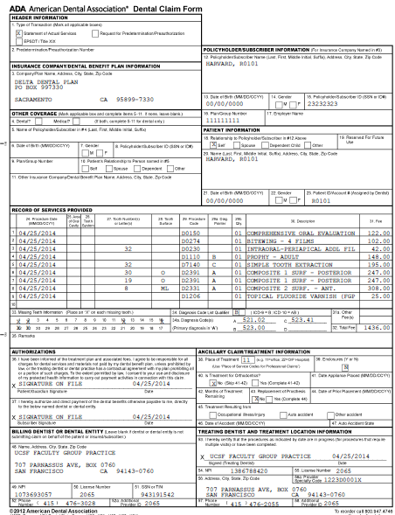
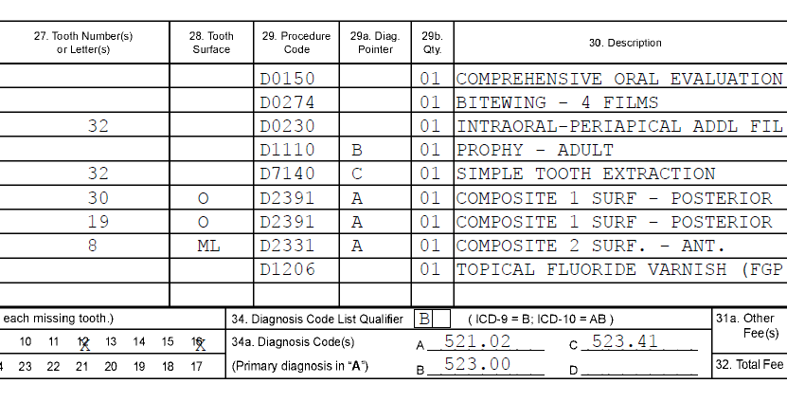
SNODDS to ICD to Dental Claim Form
(paper or electronic works the same way)
Notes:
And that is all the information will flow.
The issue now is getting dentists to use the codes. Since there is not a common electronic dental record, the practice management software systems have to be updated to capture and transmit diagnosis. Schein has made a commitment to do that in their cloud version. Problem is that dentists don’t regularly update PMS.
ADA Summit brought PMS to table to talk about the issue. And there is follow-up to the summit, so there is work going on to bridge this divide.

Slide 55
National Dental Enrollment
Source: NADP 2017 Enrollment Report
Notes:
And, commercial carriers will not require something that they know dentists don’t have the capability to do because their products are network based and any carrier that losses a large portion of their network over this type of change would lose market share.

Slide 56
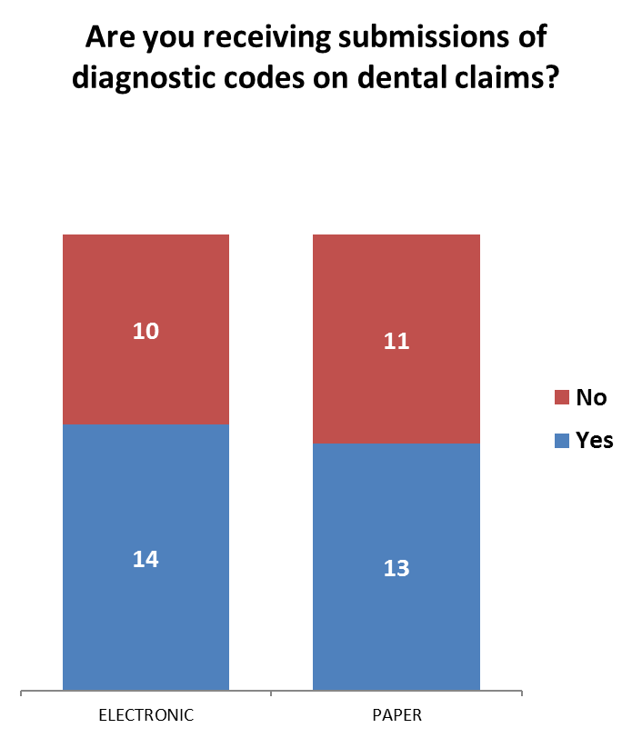
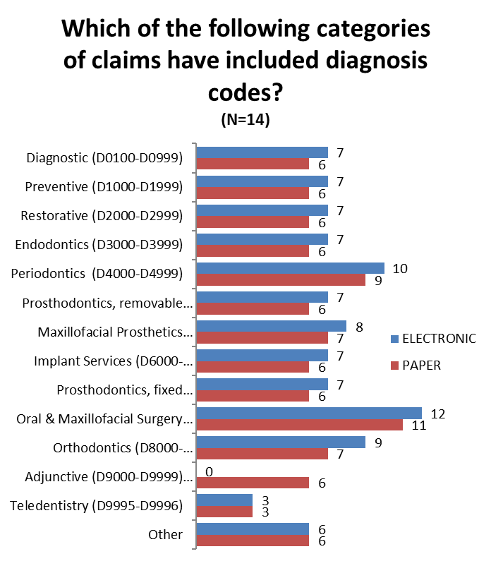
Diagnostic Codes on Claims
Notes:
Now, carries are getting diagnosis and some are using it.

Slide 57
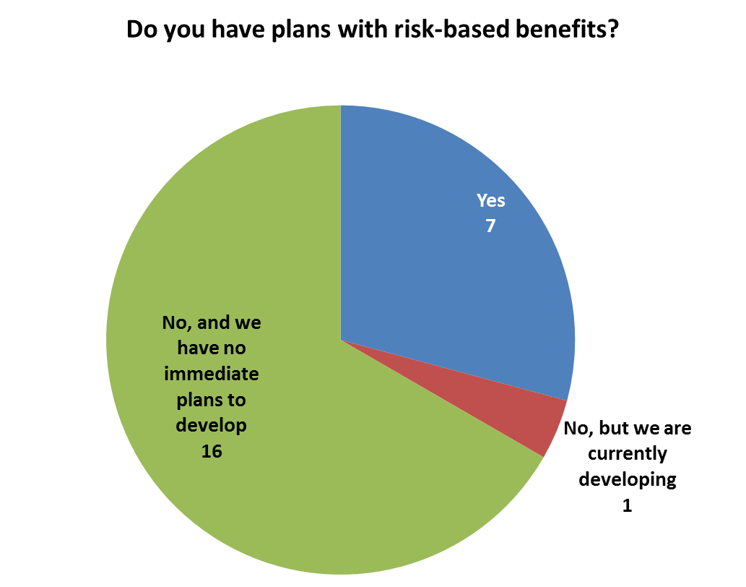
Diagnostic Codes and Risk Based Benefits
Are you currently utilizing diagnostic codes you receive for the adjudication of dental claims?
Of the 7 plans that have plans with risk-based benefits all of them are currently utilizing diagnostic codes for the adjudication of dental claims.
Notes:
Primarily for risk based benefits. To add coverage or benefits, dentists have to report. So there is some progress; not just the universal progress you crave.

Slide 58

Medicare Advantage FDR Basics
First Tier
Any party that enters into a written agreement, acceptable to CMS, with a Medicare Advantage Organization (MAO) or Part D sponsor or applicant to provide administrative or health care services to a Medicare eligible individual under the Medicare Advantage (MA) or Part D program.
Downstream
Any party that enters into an acceptable written arrangement below the level of the arrangement between an MAO or Part D sponsor and a first tier entity. These written arrangements continue down to the level of the ultimate provider of both health and administrative services.
Related Entity
Any entity that is related to an MAO or Part D sponsor by common ownership or control and: performs some of the MAO or Part D sponsor’s management functions under contract or delegation; furnishes services to Medicare enrollees under an oral or written agreement; or leases real property or sells materials to MAO or Part D plan sponsor at a cost of more than $2,500 during a contract period.
Common FDR Examples
Pharmacies • Pharmacy Benefit Managers (PBMs) • Dental • Behavioral Health • Vision • Network Providers • Provider Credentialing Services • Claims Processing Entities • Fulfillment Vendors • Sales and Marketing Agents
5
Notes:
So if there are not real pushes from consumers or employers in the commercial market to integrate dental care. What about the MA market.
Most added dental benefits are administered by FDR’s—separate contractors.

Slide 59
What FDRs are now required to do
Exercise oversight of MAO’s compliance efforts
Maintain an effective compliance program that meets all of the compliance program requirements
Investigate, correct and document all instances of suspected non-compliance
Have systems in place to train employees on job functions and general compliance (Standard of Conduct, FWA, privacy)
Have a formal delegation oversight function (e.g., vendor management program), if functions are delegated to the FDR
6
Notes:
FDRs are being asked to do more, but most of that is in the documentation of administration of the program. There is a lot of work there, but it is not integrated or with value based payments.

Slide 60
What Dental FDRs are not required to do
Value-based Payments are voluntary / focused on medical
  End-Stage Renal Disease Quality Incentive Program (ESRD QIP)
  Hospital Value-Based Purchasing (HVBP) Program
  Hospital Readmission Reduction (HRR) Program
  Value Modifier (VM) Program (also called the Physician Value-Based Modifier or PVBM)
  Hospital Acquired Conditions (HAC) Reduction Program
  Skilled Nursing Facility Value-Based Program (SNFVBP)
  Home Health Value Based Program (HHVBP)
6
Notes:
Value based payments are very specific voluntary programs focused on medical

Slide 61
Future MA Models of Care
Members
As care delivery evolves through more effective Models of Care, MAOs will continue to work with and expect delivery partners to participate in building stronger and more effective programs for their members, included payment models.
FDRs, like dental plans should move ahead in exploring how these systems can work in their care systems.
Member Experience
MAO
Models
of
Care
Provider Engagement & Contracting
Community & State Programs
Providers
Operations & Analytics
Care Management and Coordination
FDRs
23
Notes:
But, seeing what MA plans are being required to do, dental plans serving MA plans can prepare now for how they could better integrate. This will make them better potential partners.

Slide 62
CONTACT INFORMATION:
Evelyn F. Ireland, CAE
NADP Executive Director
eireland@nadp.org
972-458-6998 x101
www.nadp.org

