Slide 1
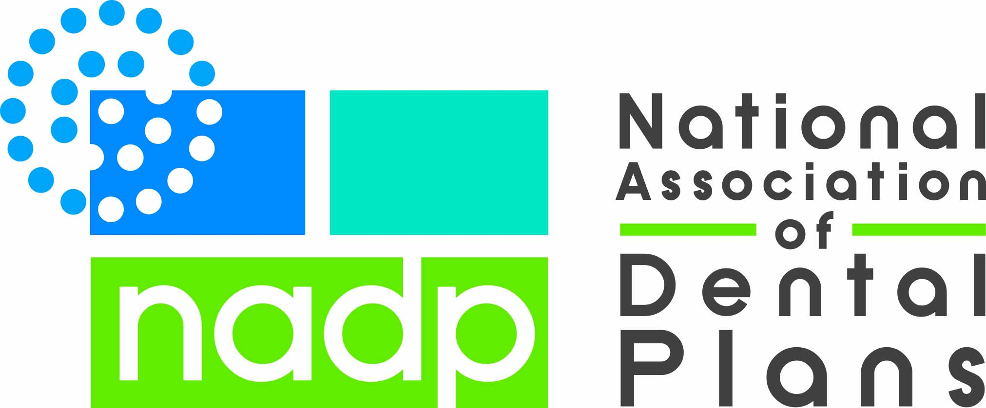
ADA May 2019
Market Overview
Notes:
One of NADP’s primary services is collecting and publishing data on the dental benefits industry. NADP not only collects data from the industry, do surveys of consumers and employers, look at public sources of data and commission others to do studies relevant to particular segments of the market.
This is a compilation of NADP enrollment data to show where MA fits in the market, data from a commissioned study of MA plans in 2017, and direct analysis of CMS MA data files.
NOTE: Where NADP data differs from other sources, it is likely the collection methodology that creates the differences. NADP discloses methodology in all reports.

Slide 2
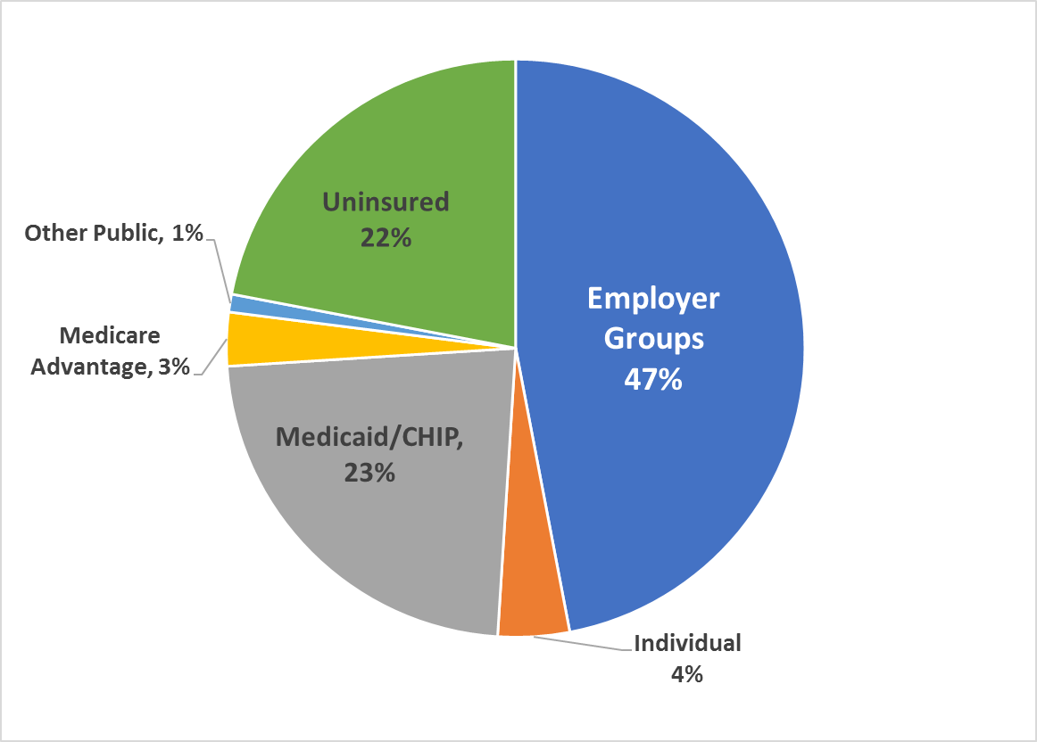
2017 Sources of Dental Coverage
Only 22% of Americans have no dental benefits.
  35% of the uninsured are over 65 without coverage
  Most of the remaining uninsured are employed—primarily in small businesses that do not offer dental coverage
  A small fraction of the population has access to dental benefits but do not purchase coverage.
A little more than half of the population gets dental benefits in the private market—through employers or by purchasing as an individual.
  Less than 4% of the population has individual coverage for dental services.
Just over a quarter of the population gets dental benefits through a public program, i.e. Medicaid, CHIP, Medicare Advantage, or other public programs like Indian Health Services.
  A segment of the senior population has maintained coverage from prior employment and some purchase dental benefits as individuals outside of MA plans
SOURCE: NADP 2018 Dental Benefits Report: Enrollment, October 2018, pg. 9, Dallas, TX
Notes:
About 3% of the population with coverage has benefits through MA plans (10.9M—see slide 4).
As of 2017 only 22% of Americans (71.9M) are dentally uninsured and seniors are 35% of this number (25.2M).

Slide 3
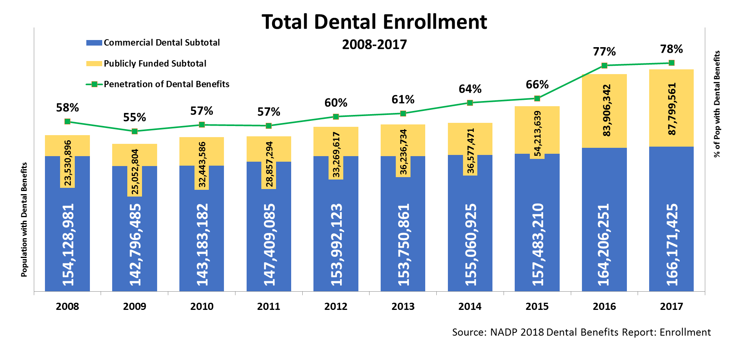
National Dental Enrollment
Notes:
At the end of 2017 the US population was 326,965,105 and 78% had dental benefits—about a quarter of population gets from public programs, just over half of population has private coverage.
Public program expansion comes primarily from the combination of Medicaid expansion under the ACA and state addition of adult dental benefits (see slides 13-15)

Slide 4
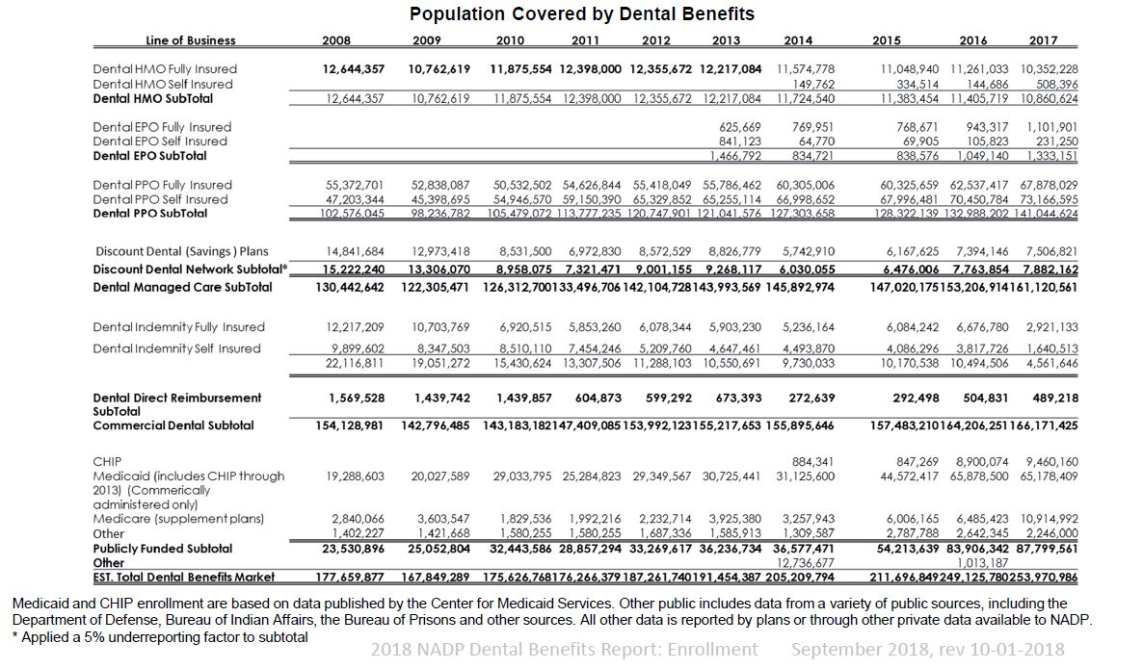
Notes:
The big expansion of the population with access to dental benefits since 2014 is in public programs. Between 2014 and 2017, the population with dental benefits through Medicaid more than doubled while the known population with dental benefits through MA programs tripled.
NOTE: Some of the increases are not year-to-year enrollment jumps, but better reporting as a result of ACA requirements.
For MA, the 2017 Medicare enrollment is fully based on an analysis of CMS Medicare landscape files where NADP only included enrollment in plans that had at minimum a “preventive” benefit, i.e. at least an office visit or cleaning. Plans with only a dental x-ray benefit were excluded.
In years prior to 2017, NADP relied on carrier reporting of Medicare enrollment.

Slide 5
National Dental Enrollment
Source: NADP 2017 Enrollment Report
Notes:
And, commercial carriers will not require something that they know dentists don’t have the capability to do because their products are network based and any carrier that losses a large portion of their network over this type of change would lose market share.

Slide 6
National Dental Premium Funding Trends
Source: NADP 2018 Enrollment Report
Notes:
Even though more of the cost is being shifted to consumers and they are more often having to purchase their group coverage with no employer contribution, consumers remain satisfied with their dental benefits.

Slide 7
Relationship with Dental Provider and type of dental benefit related to most recent dental visit
SOURCE: 2018 NADP Survey of Consumers
Notes:
The type of dental benefit also plays a part in the frequency of visits. Those with group dental benefits, and those who purchase an individual benefit off exchange, are most likely to have had a dental visit in the past year.
A similar relationship exists with those who have had dental benefits the longest. More experience with dental benefits seems to encourage more frequent visits to a dentist for preventive care.

Slide 8
Annual Maximum Trend

